Slide 1
FlingOS : Using C# for an OS
Edward Nutting, Founder

Slide 2
Welcome
.NET South West and BCS here tonight
Fire exits
This evening is being recorded
Will be uploaded to YouTube
Please ask questions both during and after
Afterwards:
Questions
Head to the pub

Slide 3
FlingOS
Introduction

Slide 4
What is FlingOS?
An educational operating system
Backed up by:
Over 30 articles
10 tutorial videos
Free and open-source
Our OS is written in C# - we’ll come on to that…

Slide 5
What’s the purpose of FlingOS?
Primary aims:
To provide resources for learning and teaching OS dev
To provide a way for high level developers to transition to low level
Secondary aims:
To raise awareness of educational problems
To encourage academics and industry to tackle the problems (in a new way)

Slide 6
Why is it necessary?
Online resources are weak
OSDev.org
OSDever.net
Other resources aren’t appropriate for learning
Minix3
Linux
Majority of existing developers are high level
Almost all new students will be high-level
New Computer Science National Curriculum (Key Stages 1 to 4)
Majority of University teaching is high-level

Slide 7
So why C#?
Familiar high-level language
Transition from Java to C# is very easy
Transition from other high level to C# is easier than high level to C
Accessible
C is hard for students, particularly high level devs, to learn
C is harder than many existing developers realise
Portable
Recently tested Mono support
Powerful
We’ll come onto this

Slide 8
Expectations for students
We expect students to either:
Be familiar with at least one programming language
Or be studying a formal course
We hope students will:
Find our resources useful, easy to use
Take advantage of all 3 types of learning on offer
See that low-level isn’t that hard and is at least the near future (IoT!)

Slide 9
Technical background
Briefly:
- C# vs Java vs Others
- C# vs. C
- Compiler structure
- OS structure

Slide 10
C# vs. Java vs. Others
C#
Java and others
IL code is:
Well defined
Well documented
Highly stable
Easy to read
Easy to document
Low bloat
Easy to hook into (no need for an entire custom compiler)
Bytecode (or similar) is:
Well defined
Well documented
Stable
Harder to read (In our opinion)
Harder to document well
Bloated syntax
Hard to hook into (without an entire custom compiler)

Slide 11
Is C# as powerful as C?
C#
C
Pointers: Yes
Manual managed memory: Optional
Structured (Classes, namespaces): Yes
Native compilation as standard: No
High performance: No
Well defined: Yes
Portable: Yes
By paradigm
Can be broken
Pointers: Yes
Manual managed memory: Mandatory
Structured: No
Native compilation as standard: Yes
High performance: Yes
Well defined: No
Too many variations and customisations
Portable:
Not necessarily

Slide 12
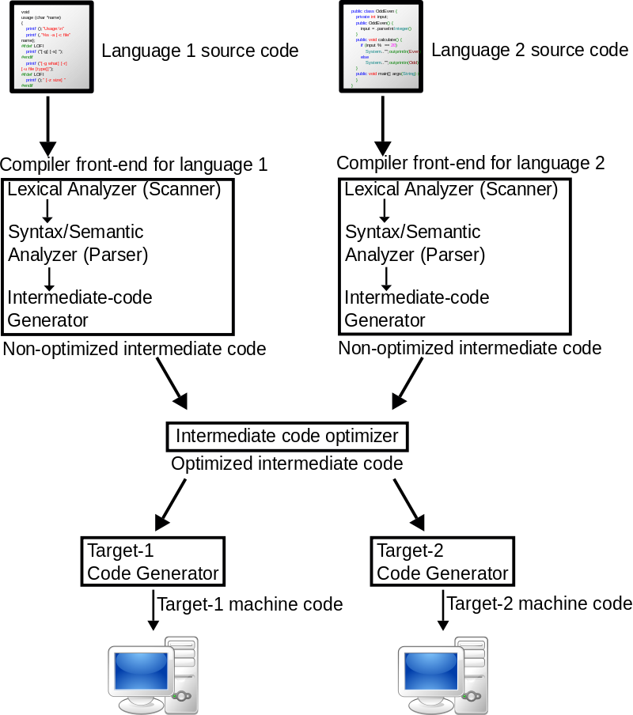
Compiler structure
"Compiler" by I, Surachit.
Licensed under CC BY-SA 3.0 via Commons
https://commons.wikimedia.org/wiki/File:Compiler.svg#/media/File:Compiler.svg

Slide 13
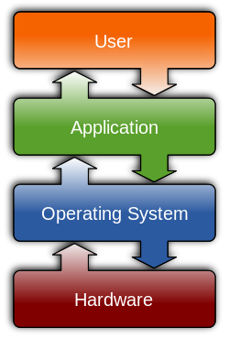
OS Structure
"Operating system placement" by Golftheman - Own work.
Licensed under CC BY-SA 3.0 via Wikimedia Commons
https://commons.wikimedia.org/wiki/File:Operating_system_placement.svg#/media/File:Operating_system_placement.svg

Slide 14
Technical details
Let’s take a look at some details and demos…

Slide 15
I have yet to meet a C compiler that is more friendly and easier to use than eating soup with a knife.
Unknown Origin (http://www.gdargaud.net/Humor/QuotesProgramming.html)
C# to machine code
Our approach really isn’t that complex…

Slide 16
Compiling
C# to IL : MSBuild
IL to ASM : FlingOS (x86 or MIPS)
ASM to Machine : NASM/GCC
Linker : Ld
Compile to:
.ISO (kernel)
.A and .ELF files (drivers)

Slide 17
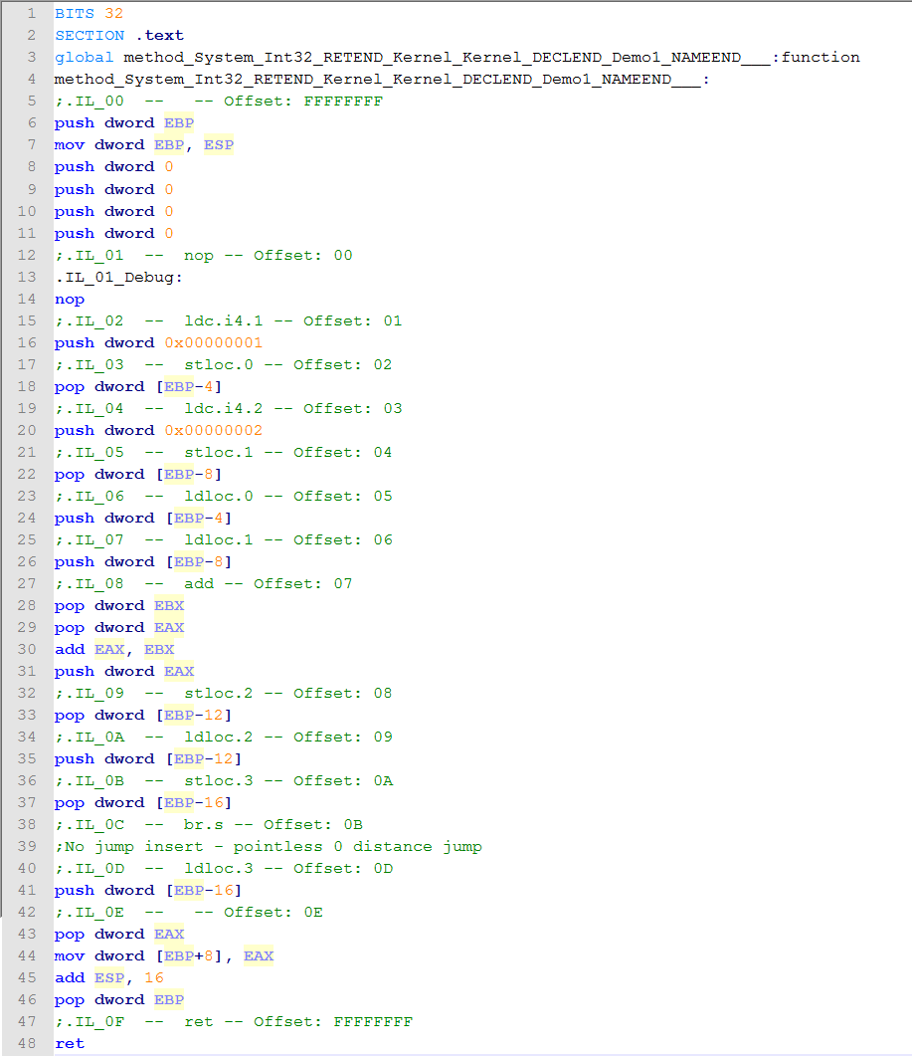
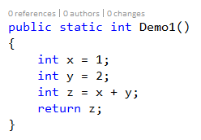
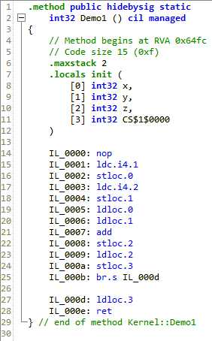
Some compiled C#

Slide 18
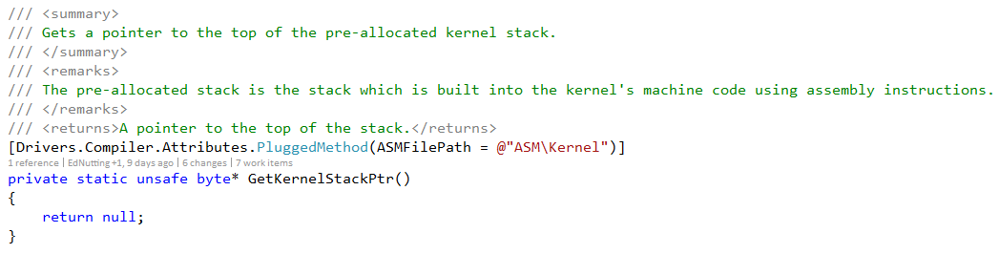
Filling some gaps
C# attributes
ASM Plugging – direct substitution
Replacing the .NET Framework – some care required at the edges

Slide 19
C# for an OS
Are you insane? Probably, but with good reasons.

Slide 20
Getting started…
There’s a few prerequisites
Processor initialisation has to be done in ASM
Plug files can be sequenced to place them at start (or elsewhere) in OS
Static constructors
Calls automatically filled in
BUT: Can omit calling the init function if you want to!
The Main method
Marked with attribute – not detected by name
Allows:
Compile-time specification of desired entrypoint
Drivers using name “Main” to be built into the OS without conflict/confusion
Example: FlingOS Tutorial C# Sample

Slide 21
What about managed memory?
The Heap
Any custom implementation you like
Not used directly by compiler
The Garbage Collector
Any custom implementation you like
Automatic calls inserted by compiler
GC functions marked with attributes
Example: FlingOS codebase

Slide 22
What about exceptions?
Exception handler methods
Again, marked by attributes
Only 4 functions to implement
Handlers implemented in C# with minimal ASM plugging
Example: Throwing an exception
Example: Handling an exception
Filters on exception handlers? Sadly not yet.
What about standard runtime checks? Yes! Compiler inserts them.

Slide 23
FlingOS
System Capabilities

Slide 24
Example: Using the system
Let’s take a quick look…

Slide 25
Example: Multi-tasking
FlingOS is a multitasking OS
Examples:
Initialisation code
Starting a process / thread
Sleeping a thread
Seen it running! (Hopefully)

Slide 26
Example: IPC using messages
FlingOS has two forms of IPC:
Message passing (0 to 8 byte messages)
Pipes (buffered, synchronous, blocking/non-blocking)
Example: Using message passing
What about security?
We’ll get there
But for now, we’re just trying to demonstrate the concept
FlingOS is trying to simplify a complex subject – security is important to recognise and highlight but can significantly complicate sample code

Slide 27
Example: IPC using pipes
Pipes:
Unidirectional
Buffered
Blocking or non-blocking operations on same pipe
Created by:
Process A announces pipe outpoint is available
Process B searches available outpoints for desired type X
Process B requests a connection to Process A of pipe type X
Process A can write data, Process B can read data
Example: Using pipes

Slide 28
Other capabilities
PS2
ATA
PCI
USB (2.0 – MSDs)
And various other bits
Recent work means ATA, PCI and USB are currently unstable.
Drivers are sound but were written for a single tasking system. We need to rework them a bit to make them run in the new multitasking environment.

Slide 29
C# for an OS
Debugging

Slide 30
FlingOS Debugger
Yes, we have debugger support!
Command line (direct to guest) or GUI (from host)
Fully understands threads, processes, args/locals, object types (and fields), strings and more
Breakpoints in specific places
Working on arbitrary BPs
GUI needs a bit of work but it’s perfectly usable.
Example: Using the FlingOS debugger

Slide 31
Alternatives?
GDB is an alternative
But our research into is has shown support for C# will require a lot of work
Are there alternatives? Probably, but with our own debugger, we can shown easily how they work – keeping it simple, reducing dependencies

Slide 32
IDE integration?
Visual Studio integration is very hard
It would be nice but:
Time consuming
Often only works for one version of VS at a time
Creates a dependency on VS.
At the moment, FlingOS does work with Mono/XBuild

Slide 33
FlingOS
What else can we do…

Slide 34
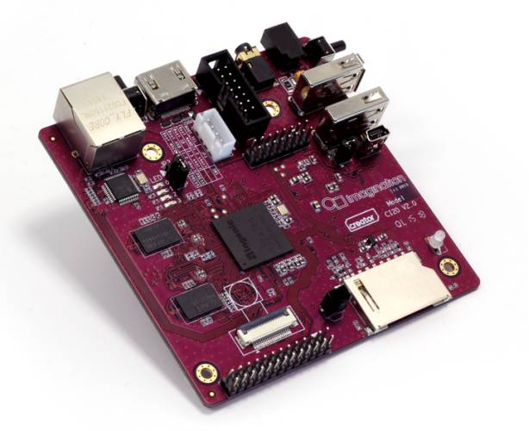

FlingOops™ - Behavioural testing
Behavioural testing of our compiler
Cross-platform MIPS/x86 – PCs or Imagination Technologies Creator CI20
Developed this summer by intern Roland Baranyi
®
Imagination Technologies and the Imagination Logo are trademark(s) or registered trademark(s) of Imagination Technologies Limited and/or its affiliated group companies in the United Kingdom and/or other countries.

Slide 35
Our plan
Grow our codebase
Add support for more major processor architectures
Create a kit for A-level and first-year university students
Expand number of articles to over 80
Further 15 tutorial videos
How? Summer interns 2016

Slide 36
Can you support us?
We’re looking for sponsorship or support for summer 2016
Sponsor a student intern from the University of Bristol
Support by guest writing, presenting here at the University, tweeting or sharing on Facebook
Please get in touch if you think you might be able to help. We’d love to have a conversation with you.
@FlingOS
Facebook.com/FlingOperatingSystem
contact@flingos.co.uk
www.flingos.co.uk/sponsor

Slide 37
Thank you
Edward Nutting, Founder
www.flingos.co.uk
contact@flingos.co.uk

Slide 38
Any questions?

